Slide 1

Organizational Behavior
Eighteenth Edition, Global Edition
Chapter 13
Leadership
Copyright © 2019 Pearson Education, Ltd. All Rights Reserved.
Notes:
If this PowerPoint presentation contains mathematical equations, you may need to check that your computer has the following installed:
1) MathType Plugin
2) Math Player (free versions available)
3) NVDA Reader (free versions available)
Welcome to this Organizational Behavior course that uses the 18th edition of the textbook, Organizational Behavior by Robbins and Judge. This is considered among the most widely used OB textbooks in the world. Robbins and Judge are recognized as definitive aggregators of OB concepts, applications, and practices. The course and this book will provide you with a resource that will benefit you throughout your degree program and your professional life.
Chapter 12: Leadership

Slide 2
Learning Objectives (1 of 2)
13.1 Summarize the conclusions of trait theories of leadership.
13.2 Identify the central tenets and main limitations of behavioral theories.
13.3 Contrast contingency theories of leadership.
13.4 Describe the contemporary theories of leadership and their relationship to foundational theories.
Notes:
After studying this chapter, you should be able to:
Summarize the conclusions of trait theories of leadership.
Identify the central tenets and main limitations of behavioral theories.
Contrast contingency theories of leadership.
Describe the contemporary theories of leadership and their relationship to foundational theories.

Slide 3
Learning Objectives (2 of 2)
13.5 Discuss the roles of leaders in creating ethical organizations.
13.6 Describe how leaders can have a positive impact on their organizations through building trust and mentoring.
13.7 Identify the challenges to our understanding of leadership.
Notes:
Additional objectives for this chapter.
Discuss the roles of leaders in creating ethical organizations.
Describe how leaders can have a positive impact on their organizations through building trust and mentoring.
Identify the challenges to our understanding of leadership.

Slide 4
Summarize the Conclusions of Trait Theories of Leadership (1 of 6)
Leadership is the ability to influence a group toward the achievement of a vision or set of goals.
  Not all leaders are managers, nor are all managers leaders.
Nonsanctioned leadership is often as important or more important than formal influence.
Notes:
Leadership is the ability to influence a group toward the achievement of a vision or set of goals. The source of this influence may be formal, such as that provided by managerial rank in an organization. But not all leaders are managers, nor, for that matter, are all managers leaders. Just because an organization provides its managers with certain formal rights is no assurance they will lead effectively.
Nonsanctioned leadership—the ability to influence that arises outside the formal structure of the organization—is often as important or more important than formal influence. In other words, leaders can emerge from within a group as well as by formal appointment.

Slide 5
Summarize the Conclusions of Trait Theories of Leadership (2 of 6)
Trait theories of leadership focus on personal qualities and characteristics.
  The search for personality, social, physical, or intellectual attributes that differentiate leaders from non-leaders goes back to the earliest stages of leadership research.
Notes:
Trait theories of leadership focus on personal qualities and characteristics. The search for personality, social, physical, or intellectual attributes that differentiate leaders from non-leaders goes back to the earliest stages of leadership research.

Slide 6
Summarize the Conclusions of Trait Theories of Leadership (3 of 6)
A comprehensive review of the leadership literature, when organized around the Big Five, has found extraversion to be the most predictive trait of effective leaders, but it is more strongly related to the way leaders emerge than to their effectiveness.
Unlike agreeableness and emotional stability, conscientiousness and openness to experience also showed strong relationships to leadership, though not quite as strong as extraversion.
Notes:
A comprehensive review of the leadership literature, when organized around the Big Five, has found extraversion to be the most important trait of effective leaders, but it is more strongly related to the way leaders emerge than to their effectiveness.
Sociable and dominant people are more likely to assert themselves in group situations, but leaders need to make sure they’re not too assertive—one study found leaders who scored very high on assertiveness were less effective than those who were moderately high.
Unlike agreeableness and emotional stability, conscientiousness and openness to experience also showed strong relationships to leadership, though not quite as strong as extraversion.

Slide 7
Summarize the Conclusions of Trait Theories of Leadership (4 of 6)
Good leaders who like being around people:
  Are able to assert themselves (extraverted).
  Are disciplined and able to keep commitments they make (conscientious).
  Have an apparent advantage when it comes to leadership.
Notes:
The trait approach does have something to offer. Leaders who like being around people and are able to assert themselves (extraverted), who are disciplined and able to keep commitments they make (conscientious), do have an apparent advantage when it comes to leadership, suggesting good leaders do have key traits in common. One reason is that conscientiousness and extraversion are positively related to leaders’ self-efficacy, which explained most of the variance in subordinates’ ratings of leader performance. People are more likely to follow someone who is confident she’s going in the right direction.

Slide 8
Summarize the Conclusions of Trait Theories of Leadership (5 of 6)
Another trait that may indicate effective leadership is emotional intelligence.
    A core component of EI is empathy.
People high in EI are more likely to emerge as leaders, even after taking cognitive ability and personality into account.
Notes:
Another trait that may indicate effective leadership is emotional intelligence (EI), discussed in Chapter 4. A core component of EI is empathy. A leader who effectively displays and manages emotions will find it easier to influence the feelings of followers, by both expressing genuine sympathy and enthusiasm for good performance and by using irritation for those who fail to perform.
Recent research has demonstrated that people high in EI are more likely to emerge as leaders, even after taking cognitive ability and personality into account.

Slide 9
Summarize the Conclusions of Trait Theories of Leadership (6 of 6)
Two conclusions:
  Traits can predict leadership.
  Traits do a better job predicting the emergence of leaders than they do at distinguishing between effective and ineffective leaders.
Notes:
Based on the latest findings, we offer two conclusions. We can say that traits can predict leadership. Second, traits do a better job predicting the emergence of leaders and the appearance of leadership than they do at distinguishing between effective and ineffective leaders. The fact that an individual exhibits the traits and that others consider him or her a leader does not necessarily mean that he or she will be an effective one.
Trait theories help us predict leadership, but they don’t fully help us explain leadership.

Slide 10
Central Tenets and Main Limitations of Behavioral Theories (1 of 3)
Behavioral theories of leadership imply we can train people to be leaders.
  Ohio State Studies found two behaviors that accounted for most leadership behavior:
    Initiating structure
    Consideration
Notes:
While trait research provides a basis for selecting the right people for leadership, behavioral theories of leadership imply that we can train people to be leaders.
The most comprehensive theories resulted from the Ohio State Studies which sought to identify independent dimensions of leader behavior. Beginning with more than a thousand dimensions, the studies narrowed the list to two that substantially accounted for most of the leadership behavior described by employees: initiating structure and consideration.
Initiating structure is the extent to which a leader defines and structures his or her role and those of subordinates to facilitate goal attainment. It includes behavior that attempts to organize work, work relationships, and goals. A leader high in initiating structure is someone who “assigns group members to particular tasks,” “expects workers to maintain definite standards of performance,” and “emphasizes the meeting of deadlines.”
Consideration is the extent to which a leader has job relationships that are characterized by mutual trust, respect for employees’ ideas, and regard for their feelings. A leader high in consideration helps employees with personal problems, is friendly and approachable, treats all employees as equals, and expresses appreciation and support.

Slide 11
Central Tenets and Main Limitations of Behavioral Theories (2 of 3)
The GLOBE study suggests there are international differences in preference for initiating structure and consideration.
  Found that leaders high in consideration would succeed best in where cultures did not favor unilateral decision making.
Notes:
Some research from the GLOBE study suggests that there are international differences in preference for initiating structure and consideration. Research found that leaders high in consideration would succeed best in countries where cultural values did not favor unilateral decision making, such as Brazil. In contrast, the French have a more bureaucratic view of leaders and are less likely to expect them to be humane and considerate. A leader high in initiating structure (relatively task-oriented) will do best there and can make decisions in a relatively autocratic manner. In other cultures, both dimensions may therefore be important.

Slide 12
Central Tenets and Main Limitations of Behavioral Theories (3 of 3)
Summary of Trait Theories and Behavioral Theories
  Leaders who have certain traits and who display culturally appropriate consideration and structuring behaviors do appear to be more effective.
  Traits and behaviors do not guarantee success.
    Context matters too.
Notes:
In summary, leaders who have certain traits and who display culturally appropriate consideration and structuring behaviors do appear to be more effective. Future research is needed to integrate these approaches. As important as traits and behaviors are in identifying effective or ineffective leaders, they do not guarantee success. The context matters too.

Slide 13
Contrast Contingency Theories of Leadership (1 of 7)
The Fiedler contingency model: effective group performance depends upon the proper match between the leader’s style of interacting with subordinates and the degree to which the situation gives control to the leader.
  The least preferred coworker (LPC) questionnaire:
      Task- or relationship-oriented.
      Assumes leadership style is fixed.
Notes:
The first comprehensive contingency model for leadership was developed by Fred Fiedler, who proposed that effective group performance depends on the proper match between the leader’s style of interacting with subordinates and the degree to which the situation gives control to the leader.
The first step in the Fiedler contingency model is identifying leadership style. Fiedler believed that a key factor in leadership success is the individual’s basic leadership style. He created the least preferred coworker (LPC) questionnaire for this purpose, to measure whether a person is task- or relationship-oriented.

Slide 14
Contrast Contingency Theories of Leadership (2 of 7)
Defining the Situation
  Contingency dimensions:
    Leader-member relations
    Task structure
    Position power
Notes:
After assessing leadership style, it is necessary to match the leader with the situation. Fiedler has identified three contingency or situational dimensions:
Leader–member relations—the degree of confidence, trust, and respect members have in their leader.
Task structure—the degree to which the job assignments are procedural.
Position power—the degree of influence a leader has over power variables such as hiring, firing, discipline, promotions, and salary increases.
The next step is to evaluate the situation in terms of these three contingency variables. Leader–member relations are either good or poor. Task structure is either high or low. Position power is either strong or weak. Fiedler states the better the leader–member relations, the more highly structured the job, and the stronger the position power, the more control the leader has.

Slide 15
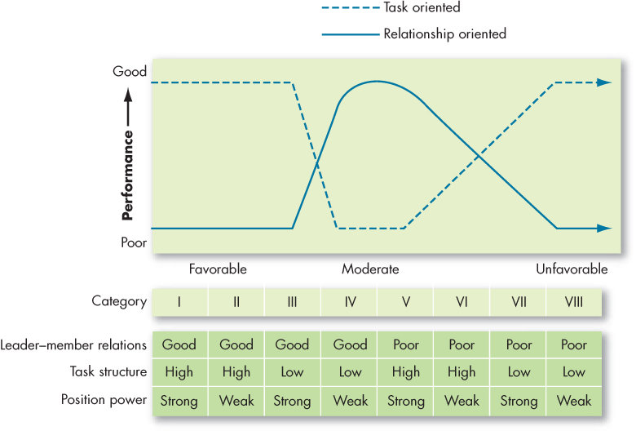
Contrast Contingency Theories of Leadership (3 of 7)
Exhibit 13-1 Findings from the Fiedler Model
Notes:
As shown in Exhibit 12-1, Fiedler concluded that task-oriented leaders tend to perform better in situations that were very favorable to them as well as in situations that were very unfavorable. Fiedler would predict that when faced with a category I, II, Ill, VII, or VIII situation, task-oriented leaders perform better. Relationship-oriented leaders, however, perform better in moderately favorable situations—categories IV through VI. Fiedler has condensed these eight situations to three.

Slide 16
Contrast Contingency Theories of Leadership (4 of 7)
Situational leadership theory (SLT) is a contingency theory that focuses on the followers.
    Successful leadership is achieved by selecting the right leadership style, which is contingent on the level of the followers’ readiness.
Notes:
Although LPC theory is the most researched contingency theory, three others deserve mention.
First, situational leadership theory (SLT) is a contingency theory that focuses on the followers. It proposes that successful leadership is achieved by selecting the right leadership style, which is contingent on the level of the followers’ readiness. The term readiness refers to the extent to which people have the ability and willingness to accomplish a specific task. A leader should choose one of four behaviors depending on follower readiness. If followers are unable and unwilling to do a task, the leader needs to give clear and specific directions; If they are unable but willing, the leader needs to display high task orientation to compensate for followers’ lack of ability and high relationship orientation to get them to “buy into” the leader’s desires. Conversely, if followers are able but unwilling, the leader needs to use a supportive and participative style. If they are both able and willing, the leader doesn’t need to do much.
SLT has intuitive appeal. Yet, research efforts to test and support the theory have generally been disappointing.

Slide 17
Contrast Contingency Theories of Leadership (5 of 7)
Path-goal theory:
  Contingency model of leadership that extracts key elements from the Ohio State leadership research on initiating structure and consideration and the expectancy theory of motivation.
  Derived from belief that effective leaders clarify the path to help followers achieve work goals.
Notes:
One of the most respected approaches to leadership is the path-goal theory, developed by Robert House. It is a contingency model of leadership that extracts key elements from the Ohio State leadership research on initiating structure and consideration and the expectancy theory of motivation.
The term “path-goal” is derived from the belief that effective leaders clarify the path to help their followers achieve their work goals. According to path-goal theory, whether a leader should be directive or supportive or should demonstrate some other behavior depends on complex analysis of the situation. The theory predicts the following: directive leadership yields greater satisfaction when tasks are ambiguous or stressful than when they are highly structured and well laid out, while supportive leadership results in high performance and satisfaction when employees are performing structured tasks. Directive leadership is likely to be perceived as redundant among employees with high ability or considerable experience.

Slide 18
Contrast Contingency Theories of Leadership (6 of 7)
The leader-participation model relates leadership behavior and participation in decision making.
  Leader behavior must adjust to reflect the task structure.
Notes:
The final contingency theory is the leader-participation model which argues that the way the leader makes decisions is as important as what she or he decides. The model, developed by Victor Vroom and Phillip Yetton, relates leadership behavior and participation in decision-making. Like path-goal theory, it says leader behavior must adjust to reflect the task structure.

Slide 19
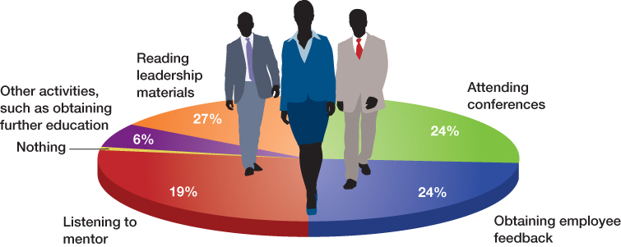
Contrast Contingency Theories of Leadership (7 of 7)
OB POLL How Are You Developing Your Leadership Skills
Note: Survey of 700 respondents.
Source: Based on J. Brox, “The Results Are In: How Do You Ensure You’re Constantly Developing as a Leader?” May 14, 2013, http://www.refreshleadership.com/index.php/2013/05/results-ensure-youre-constantly-developing-leader/#more-4732.
Notes:
Consider the OB Poll … and your own quest for leadership skills.

Slide 20
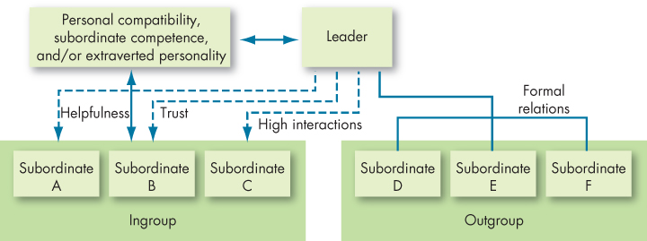
Contemporary Theories of Leadership (1 of 12)
Exhibit 13-2 Leader–Member Exchange Theory from
Notes:
The leader-member exchange (LMX) theory argues that because of time pressures, leaders establish a special relationship with a small group of their followers (see Exhibit 12-2). These individuals make up the in-group—they are trusted, get a disproportionate amount of the leader’s attention, and are more likely to receive special privileges. The theory proposes that early in the history of the interaction between a leader and a given follower, the leader implicitly categorizes the follower as an “in” or an “out” and that relationship is relatively stable over time. The leader does the choosing on the basis of the follower’s characteristics.
Research to test LMX theory has been generally supportive, with substantive evidence that leaders do differentiate among followers. These disparities are far from random; and followers with in-group status will have higher performance ratings, engage in more helping or “citizenship” behaviors at work, engage in less deviant or “counterproductive” behaviors at work, and report greater satisfaction with their superior.

Slide 21
Contemporary Theories of Leadership (2 of 12)
Exhibit 13-3 Key Characteristics of a Charismatic Leader
1. Vision and articulation. Has a vision—expressed as an idealized goal—that proposes a future better than the status quo; able to clarify the importance of the vision in terms that are understandable to others.
2. Personal risk. Willing to take on high personal risk, incur high costs, and engage in self-sacrifice to achieve the vision.
3. Sensitivity to follower needs. Perceptive of others’ abilities and responsive to their needs and feelings.
4. Unconventional behavior. Engages in behaviors that are perceived as novel and counter to norms.
Source: Based on J. A. Conger and R. N. Kanungo, Charismatic Leadership in Organizations (Thousand Oaks, CA: Sage, 1998), 94.
Notes:
Charismatic leadership theory was proposed by Robert House, stating that followers make attributes of heroic or extraordinary leadership abilities when they observe certain behaviors, as seen in Exhibit 12-3. General characteristics are: they have vision; they are willing to take personal risk; they are sensitive to followers’ needs; and they exhibit extraordinary behaviors.

Slide 22
Contemporary Theories of Leadership (3 of 12)
Are Charismatic Leaders Born or Made?
  Some individuals are born with charismatic traits, others are trained to exhibit charismatic behaviors.
  Develop the aura of charisma.
    Use your passion to generate enthusiasm.
      Speak in an animated voice, reinforce your message with eye contact and facial expressions, and gesture for emphasis.
      Bring out the potential in followers by tapping into their emotions and create a bond that inspires them.
Notes:
Are charismatic leaders born or made? Some individuals are born with traits that make them charismatic. Most experts believe individuals can also be trained to exhibit charismatic behavior.
To further develop an aura of charisma, use your passion as a catalyst for generating enthusiasm. Speak in an animated voice, reinforce your message with eye contact and facial expressions, and gesture for emphasis. Bring out the potential in followers by tapping into their emotions, and create a bond that inspires them. Remember, enthusiasm is contagious!

Slide 23
Contemporary Theories of Leadership (4 of 12)
How Charismatic Leaders Influence Followers
  Articulating an appealing vision.
  Developing a vision statement.
  Establishing a new set of values.
  Conveying courage and conviction about the vision.
Notes:
How does a charismatic leader influence followers? By articulating an appealing vision, developing an accompanying vision statement, conveying a new set of values, and demonstrating courage and conviction about the vision. Followers “catch” the emotions their leader is conveying.

Slide 24
Contemporary Theories of Leadership (5 of 12)
Does Effective Charismatic Leadership Depend on the Situation?
  People are especially receptive when they sense a crisis or when they are under stress.
Notes:
Does effective charismatic leadership depend on the situation? Charisma appears to be most appropriate when the follower’s task has an ideological component or when the environment involves a high degree of stress and uncertainty. People are especially receptive when they sense a crisis or when they are under stress.
This may explain why, when charismatic leaders surface, it’s more likely to be in politics, religion, wartime; or when a business firm is in its infancy or facing a life-threatening crisis.

Slide 25
Contemporary Theories of Leadership (6 of 12)
The Dark Side of Charismatic Leadership
  Many leaders don’t necessarily act in the best interest of their companies.
    Many have allowed their personal goals to override the goals of the organization.
    Individuals who are narcissistic are also higher in some behaviors associated with charismatic leadership.
Notes:
Some charismatic leaders don’t necessarily act in the best interest of their companies, allowing their personal goals to override the goals of the organization. The results at companies such as Enron, Tyco, WorldCom, and HealthSouth are examples of leaders who recklessly used organizational resources for their personal benefit and executives who violated laws and ethical boundaries to inflate stock prices, allowing leaders to cash in millions of dollars in stock options.
It’s little wonder research has shown that individuals who are narcissistic are also higher in some behaviors associated with charismatic leadership. It’s not that charismatic leadership isn’t effective; overall, it is. But a charismatic leader isn’t always the answer. Success depends, to some extent, on the situation and on the leader’s vision.

Slide 26
Contemporary Theories of Leadership (7 of 12)
Exhibit 13-4 Characteristics of Transactional and Transformational Leaders
Transactional Leader
Contingent Reward: Contracts exchange of rewards for effort, promises rewards for good performance, recognizes accomplishments.
Management by Exception (active): Watches and searches for deviations from rules and standards, takes corrective action.
Management by Exception (passive): Intervenes only if standards are not met.
Laissez-Faire: Abdicates responsibilities, avoids making decisions.
Transformational Leader
Idealized Influence: Provides vision and sense of mission, instills pride, gains respect and trust.
Inspirational Motivation: Communicates high expectations, uses symbols to focus efforts, expresses important purposes in simple ways.
Intellectual Stimulation: Promotes intelligence, rationality, and careful problem solving.
Individualized Consideration: Gives personal attention, treats each employee individually, coaches, advises.
Sources: Based on B. M. Bass, Leadership and Performance Beyond Expectations (New York, NY: Free Press, 1990); and T. A. Judge and R. F. Piccolo, “Transformational and Transactional Leadership: A Meta-Analytic Test of Their Relative Validity,” Journal of Applied Psychology 89, no. 5 (2004): 755–68.
Notes:
A stream of research has focused on differentiating between transactional leaders and transformational leaders.
Transactional leaders guide or motivate their followers in the direction of established goals by clarifying role and task requirements.
Transformational leaders inspire followers to transcend their own self-interests for the good of the organization. They change followers’ awareness of issues by helping them to look at old problems in new ways; and they are able to excite, arouse, and inspire followers to put out extra effort to achieve group goals.
Exhibit 12-4 shows that transformational leadership builds on transactional leadership and produces levels of follower effort and performance beyond what transactional leadership alone can do. Transactional and transformational leadership complement each other; they aren’t opposing approaches to getting things done. The best leaders are transactional and transformational.

Slide 27
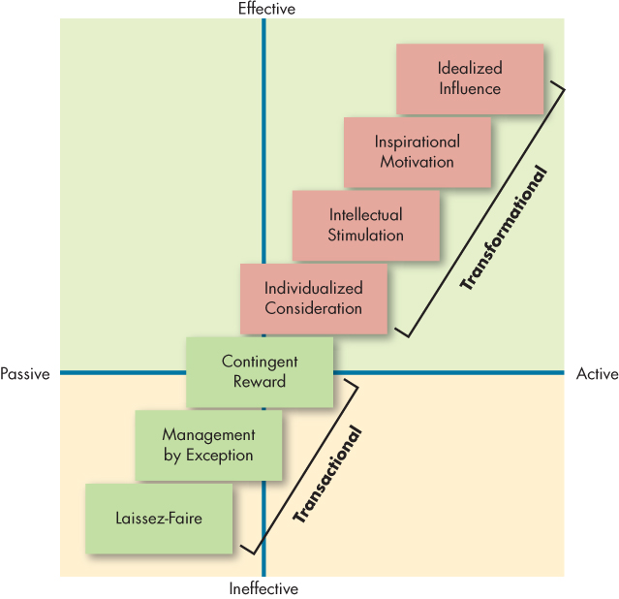
Contemporary Theories of Leadership (8 of 12)
Exhibit 13-5 Full Range of Leadership Model
Notes:
Exhibit 12-5 shows the full range of the leadership model.
Laissez-faire is the most passive and least effective type, while management by exception is slightly better. Contingent reward leadership can be effective, but will not get employees to go above and beyond the call of duty.
The remaining four correspond to transformational leadership: individualized consideration, intellectual stimulation, inspirational motivation, and idealized influence. Leaders are generally more effective when they regularly use the four I’s. Only with these styles are leaders able to motivate followers to perform above expectations and transcend their self-interests for the sake of the organization.

Slide 28
Contemporary Theories of Leadership (9 of 12)
How Transformational Leadership Works
  Creativity – theirs and others.
  Decentralization of responsibility.
  Propensity to take risks.
  Compensation is geared toward long-term results.
  Greater agreement among top managers about the organization’s goals.
Notes:
Overall, most research suggests that the reason transformational leadership works is that it inspires and motivates followers. For example, research in Germany and Switzerland found that transformational leadership improves employee job satisfaction, self-efficacy, and commitment to the leader by fulfilling follower autonomy, competence, and relatedness needs (see self-determination theory, Chapter 7)
One study found that transformational leadership leads to increased job performance and OCB by empowering employees (see Chapter 3), especially in more “organic” organizations (i.e., organizations that are adaptive and that have fluid roles, shared values, and reciprocal communication). Other research in China found that transformational leadership positively influenced workers’ helping behaviors through improving employee trust in their leaders along with prosocial motivation. Finally, multiple studies in Israel and the United Kingdom suggest that transformational leadership can improve workplace safety by increasing intrinsic motivation and prevention focus (see Chapter 7).
Companies with transformational leaders also show greater agreement among top managers about the organization’s goals, which yields superior organizational performance.
The Israeli military has seen similar results, showing that transformational leaders improve performance by building consensus among group members. Transformational leaders are able to increase follower self-efficacy, giving the group a “can do” spirit.

Slide 29
Contemporary Theories of Leadership (10 of 12)
Evaluation of Transformational Leadership
  Transformational leadership has been supported at diverse job levels and occupations, but it isn’t effective in all situations.
    It has a greater impact on the bottom line in smaller, privately-held firms than in more complex organizations.
Notes:
Transformational leadership has been supported at diverse job levels and occupations (school principals, teachers, marine commanders, ministers, presidents of MBA associations, military cadets, union shop stewards, sales reps), but it isn’t equally effective in all situations.
Transformational leadership has a greater impact on the bottom line in smaller, privately held firms than in more complex organizations. Transformational leadership may also be more effective when leaders can directly interact with the workforce to make decisions (when they have high task autonomy) than when they report to an external board of directors or deal with a complex bureaucratic structure.

Slide 30
Contemporary Theories of Leadership (11 of 12)
  Transformational versus Transactional Leadership
    Transformational leadership is more strongly correlated with a variety of workplace outcomes.
Notes:
When comparing transformational leadership with transactional leadership, research indicates transformational leadership is more strongly correlated than transactional leadership a variety of workplace outcomes.
However, transformational leadership theory is not perfect. The full range of leadership model shows a clear division between transactional and transformational leadership that may not fully exist in effective leadership.
And contrary to the full range of leadership model, the four I’s of transformational leadership are not always superior in effectiveness to transactional leadership; contingent reward leadership, in which leaders dole out rewards as certain goals are reached by employees, sometimes works as well as transformational leadership.
More research is needed, but the general supportable conclusion is that transformational leadership is desirable and effective, given the right application.

Slide 31
Contemporary Theories of Leadership (12 of 12)
Transformational versus Charismatic Leadership
  Charismatic leadership places more emphasis on the way leaders communicate – are they passionate and dynamic?
  Transformational leadership focuses more on what they are communicating – is it a compelling vision?
  Both focus on the leader’s ability to inspire followers.
Notes:
Charismatic leadership places somewhat more emphasis on the way leaders communicate (are they passionate and dynamic?), while transformational leadership focuses more on what they are communicating (is it a compelling vision?).
Still, the theories are more alike than different. At their heart, both focus on the leader’s ability to inspire followers, and sometimes they do so in the same way. Because of this, some researchers believe the concepts are somewhat interchangeable.

Slide 32
Role of Leaders in Creating Ethical Organizations (1 of 4)
Authentic Leadership
  Authentic leaders:
    Know who they are.
    Know what they believe in and value.
    Act on those values and beliefs openly and candidly.
  The result: people come to have faith in them.
Notes:
What is authentic leadership? Authentic leaders know who they are. They know what they believe in and value. And they act on those values and beliefs openly and candidly. The result: people come to have faith in them.
Recent research indicates that authentic leadership, especially when shared among top management team members, created a positive energizing effect that heightened firm performance.
Not only is authenticity important for leaders, it is important for followers, too. In a study of Belgian service companies, the joint authenticity of both leaders and followers led to the satisfaction of basic needs (see self-determination theory, Chapter 7), which in turn led to improvements in performance.⁸⁶ Much like the group- and individual-focused transformational leadership findings from the previous section, both group- and individual perceptions of authenticity on follower outcomes.

Slide 33
Role of Leaders in Creating Ethical Organizations (2 of 4)
Ethical Leadership
  Ethics touches on leadership at a number of junctures.
  Efforts have been made to combine ethical and charismatic leadership into an idea of socialized charismatic leadership – leadership that conveys other-centered values by leaders who model ethical conduct.
Notes:
Ethics touches on leadership at a number of junctures. Leaders who treat their followers with fairness, especially by providing honest, frequent, and accurate information, are seen as more effective.
Leaders must be willing to express their ethical beliefs and persuade others to follow their standards. To convey their beliefs, leaders should learn to express their moral convictions in statements that reflect values shared with their organization’s members. Leaders need to set high ethical standards, demonstrate them through their own behavior, and encourage and reward integrity in others while avoiding abuses of power.
Leaders rated as highly ethical tend to be very positively evaluated by their subordinates, who are also more satisfied and committed to their jobs as well as experience less strain and turnover intentions.
Efforts have been made by scholars to combine ethical and charismatic leadership into an idea of socialized charismatic leadership – leadership that conveys other-centered (not self-centered) values by leaders who model ethical conduct.

Slide 34
Role of Leaders in Creating Ethical Organizations (3 of 4)
Abusive Supervision
  Refers to the perception that a supervisor is hostile in their verbal and nonverbal behavior.
    Negatively affects health, leads to increased depression, emotional exhaustion, and job tension perceptions.
    Leads to decreases in organizational commitment, job satisfaction, and perceived organizational support along with increased work-family conflict.
    Can adversely affect employee performance and other employee behaviors.
Notes:
It can happen to anyone—we’re all capable of being abusive as managers.¹⁰³ Frighteningly, some research suggests that when it does occur it can be costly: current estimates suggest that it costs organizations in the United States about 23.8 billion dollars per year.
The United States also has relatively low reported levels of abusive supervision in recent research—the highest ratings of abusive supervision are actually in the eastern hemisphere, including China, the Philippines, and Taiwan; with lower ratings in the United States, Canada, and India.
Although not a form of leadership in all cases, abusive supervision refers to the perception that a supervisor is hostile in their verbal and nonverbal behavior.
Research suggests that there are a variety of dire consequences for abusive supervision. First and foremost, abusive supervision negatively affects health: it leads to increased depression, emotional exhaustion, and job tension perceptions. Second, it also leads to decreases in organizational commitment, job satisfaction, and perceived organizational support along with increased work-family conflict. Finally, it can adversely affect employee performance and other employee behaviors: victims of abusive supervision are more prone to engage in CWBs and other deviant behaviors (especially retaliatory ones directed toward their supervisors) and less prone to engage in OCBs.

Slide 35
Role of Leaders in Creating Ethical Organizations (4 of 4)
Servant Leadership
  Servant leaders go beyond their self-interest and instead focus on opportunities to help followers grow and develop.
  Characteristic behaviors include listening, empathizing, persuading, accepting stewardship, and actively developing followers’ potential.
Notes:
Scholars have recently considered ethical leadership from a new angle by examining servant leadership. Because servant leadership focuses on serving the needs of others, research has focused on its outcomes for the well-being of followers.
Characteristic behaviors include listening, empathizing, persuading, accepting stewardship, and actively developing followers’ potential.
What are the effects of servant leadership? One study of 71 general managers of restaurants in the United States and over 1,000 of their employees found that servant leaders tend to create a culture of service (see Chapter 16), which in turn, improves the restaurant performance and enhances employee attitudes and performance by increasing their identification with the restaurant. Second, there is a relationship between servant leadership and follower OCB that appears to be stronger when followers are encouraged to focus on being dutiful and responsible. Third, servant leadership increases team potency (a belief that one’s team has above-average skills and abilities), which in turn leads to higher levels of group performance. Finally, a study with a nationally representative sample found higher levels of citizenship associated with a focus on growth and advancement, which in turn was associated with higher levels of creative performance.
Servant leadership may be more prevalent and more effective in certain cultures. When asked to draw images of leaders, U.S. subjects tend to draw them in front of the group, giving orders to followers. Singaporeans tend to draw leaders at the back of the group, acting more to gather a group’s opinions together and then unify them from the rear. This suggests the East Asian prototype is more like a servant leader, which might mean servant leadership is more effective in these cultures.

Slide 36
Positive Leadership (1 of 4)
Trust and Leadership
  Trust: a psychological state that exists when you agree to make yourself vulnerable to another because you have positive expectations about how things are going to turn out.
    A primary attribute associated with leadership.
    When trust is broken, it can have serious adverse effects on a group’s performance.
Notes:
Trust is a psychological state that exists when you agree to make yourself vulnerable to another because you have positive expectations about how things are going to turn out. Trust is a primary attribute associated with leadership. When trust is broken, it can have serious adverse effects on a group’s performance. People are unlikely to look up to or follow someone they perceive as dishonest or likely to take advantage of them. Thus, as you might expect, transformational leaders do generate higher levels of trust from their followers, which in turn is related to higher levels of team confidence and, ultimately, higher levels of team performance.

Slide 37
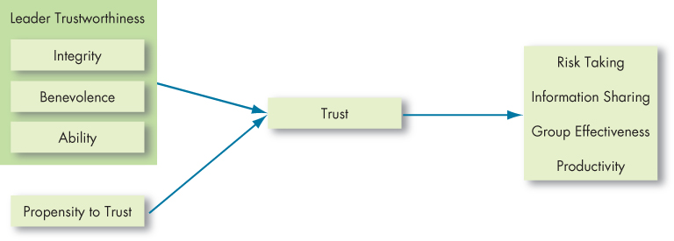
Positive Leadership (2 of 4)
Exhibit 13-6 The Nature of Trust
Notes:
Trust isn’t just about the leader; the characteristics of the followers will also influence the development of trust. What key characteristics lead us to believe a leader is trustworthy? Exhibit 12-6 shows three characteristics: integrity, benevolence, and ability.
Integrity refers to honesty and truthfulness. It seems the most critical of the three in assessing another’s trustworthiness. Benevolence means the trusted person has your interests at heart, even if yours aren’t necessarily in line with theirs. Ability encompasses an individual’s technical and interpersonal knowledge and skills.
The Outcomes of Trust:
Trust encourages taking risks.
Whenever employees decide to deviate from the usual way of doing things, or to take their supervisors’ word on a new direction, they are taking a risk.
Trust facilitates information sharing.
One big reason employees fail to express concerns at work is that they don’t feel psychologically safe revealing their views.
Trusting groups are more effective.
When a leader sets a trusting tone in a group, members are more willing to help each other and exert extra effort, which further increases trust.
Trust enhances productivity.
The bottom-line interest of companies also appears positively influenced by trust. Employees who trust their supervisors tend to receive higher performance ratings.

Slide 38
Positive Leadership (3 of 4)
Trust propensity
  Trust and Culture
  The Role of Time
  Regaining Trust
Notes:
Trust propensity refers to how likely a particular employee is to trust a leader. Some people are simply more likely to believe others can be trusted. Trust may be built on very different perceptions from culture to culture.
Time is the final ingredient in the recipe for trust. Trust doesn’t happen immediately: we come to trust people based on observing their behavior over a period of time. Trust can also be won in the ability domain simply by demonstrating competence.
Leaders who break the psychological contract with workers, demonstrating they aren’t trustworthy, will find that employees are less satisfied and less committed, have higher intentions to turnover, engage in less citizenship behavior, and have lower task performance.

Slide 39
Positive Leadership (4 of 4)
Exhibit 13-7 Career and Psychological Functions of the Mentoring Relationship
Career Functions | Psychosocial Functions
Lobbying to get the protégé challenging and visible assignments | Counseling the protégé to bolster his or her self-confidence
Coaching the protégé to help develop his or her skills and achieve work objectives | Sharing personal experiences with the protégé
Providing exposure to influential individuals within the organization | Providing friendship and acceptance
Protecting the protégé from possible risks to his or her reputation | Acting as a role model
Sponsoring the protégé by nominating him or her for potential advances or promotions | Blank
Acting as a sounding board for ideas the protégé might be hesitant to share with a direct supervisor | Blank
Notes:
A mentor is a senior employee who sponsors and supports a less-experienced employee (a protégé). Successful mentors are good teachers. They present ideas clearly, listen well, and empathize with protégés’ problems. As shown in Exhibit 12-7, mentoring relationships serve both career functions and psychosocial functions.
Traditional informal mentoring relationships develop when leaders identify a less experienced, lower-level employee who appears to have potential for future development. The protégé will often be tested with a particularly challenging assignment. If he or she performs acceptably, the mentor will develop the relationship, informally showing the protégé how the organization really works outside its formal structures and procedures.
Why would a leader want to be a mentor? Many feel they have something to share with the younger generation and want to provide a legacy. Mentoring also provides unfiltered access to the attitudes of lower-ranking employees, and protégés can be an excellent source of early warning signals that identify potential organizational problems.
You might assume mentoring is valuable for objective outcomes like compensation and job performance, but research suggests the gains are primarily psychological. So, while mentoring can have an impact on career success, research shows that it’s not as important as ability and personality.

Slide 40
Challenges to our Understanding of Leadership (1 of 4)
Much of an organization’s success or failure is due to factors outside the influence of leadership.
  In many cases, success or failure is just a matter of being in the right or wrong place at a given time.
The attribution theory of leadership says leadership is merely an attribution people make about other individuals.
Notes:
Much of an organization’s success or failure is due to factors outside the influence of leadership. In many cases, success or failure is just a matter of being in the right or wrong place at a given time.
The attribution theory of leadership says leadership is merely an attribution people make about other individuals. Thus, we attribute to leaders intelligence, outgoing personality, strong verbal skills, aggressiveness, understanding, and industriousness. At the organizational level, we tend to see leaders, rightly or wrongly, as responsible for extremely negative or extremely positive performance.

Slide 41
Challenges to our Understanding of Leadership (2 of 4)
Exhibit 13-8 Substitutes for and Neutralizers of Leadership
Defining Characteristics | Relationship-Oriented Leadership | Task-Oriented Leadership
Individual | Blank | Blank
Experience/training | No effect on | Substitutes for
Professionalism | Substitutes for | Substitutes for
Indifference to rewards | Neutralizes | Neutralizes
Job | Blank | Blank
Highly structured task | No effect on | Substitutes for
Provides its own feedback | No effect on | Substitutes for
Intrinsically satisfying | Substitutes for | Neutralizes
Organization | Blank | Blank
Explicit formalized goals | No effect on | Substitutes for
Rigid rules and procedures | No effect on | Substitutes for
Cohesive work groups | Substitutes for | Substitutes for
Source: Based on K. B. Lowe and W. L. Gardner, “Ten Years of the Leadership Quarterly: Contributions and Challenges for the Future,” Leadership Quarterly 11, no. 4 (2000): 459–514.
Notes:
Data from numerous studies collectively demonstrate that, in many situations, whatever actions leaders exhibit are irrelevant.
As shown here in Exhibit 12-8, experience and training are among the substitutes that can replace the need for a leader’s support or ability to create structure. Organizational characteristics such as explicit formalized goals, rigid rules and procedures, and cohesive work groups can also replace formal leadership, while indifference to organizational rewards can neutralize its effects. Neutralizers make it impossible for leader behavior to make any difference to follower outcomes. Sometimes the difference between substitutes and neutralizers is fuzzy.

Slide 42
Challenges to our Understanding of Leadership (3 of 4)
Selecting Leaders
  Identifying effective leaders:
    Review specific requirements for the position.
    Consider personality tests to identify leadership traits.
    Situation-specific experience is relevant.
  Plan for a change in leadership.
Notes:
The process that organizations go through to fill management positions is essentially an exercise in trying to identify individuals who will be effective leaders. You might begin by reviewing the specific requirements for the position such as knowledge, skills, and abilities that are needed to do the job effectively. Personality tests can identify traits associated with leadership—extraversion, conscientiousness, and openness to experience. Also, candidates with high emotional intelligence should have an advantage, especially in situations requiring transformational leadership. Experience is a poor predictor of leader effectiveness, but situation-specific experience is relevant.
In addition, it’s important to plan for a change in leadership.

Slide 43
Challenges to our Understanding of Leadership (4 of 4)
Training Leaders
    Leadership training is likely to be more successful with high self-monitors.
    Teach implementation skills.
    Teach trust building, mentoring, and situational-analysis.
    Behavioral training through modeling exercises can increase an individual’s charismatic leadership qualities.
    Review leadership after key organizational events.
    Train in transformational leadership skills.
Notes:
Billions are spent on leadership training and development every year. Here are some things management can do to get the maximum effect from their leadership-training budgets:
Leadership training is likely to be more successful with individuals who are high self-monitors than with low self-monitors. Second, organizations can teach implementation skills. We also can teach skills such as trust building, mentoring, and situational-analysis skills. There is evidence suggesting that behavioral training through modeling exercises can increase an individual’s ability to exhibit charismatic leadership qualities. Recent research also indicates that leaders should engage in regularly reviewing their leadership after key organizational events as part of their development. Finally, leaders can be trained in transformational leadership skills that have bottom-line results.

Slide 44
Implications for Managers (1 of 2)
For maximum leadership effectiveness, ensure that your preferences on the initiating structure and consideration dimensions are a match for your work dynamics and culture.
Hire candidates who exhibit transformational leadership qualities and who have demonstrated success in working through others to meet a long-term vision. Personality tests can reveal candidates higher in extraversion, conscientiousness, and openness, which may indicate leadership readiness.
Notes:
In summary, leadership plays a central part in understanding group behavior, because it’s the leader who usually directs us toward our goals. Knowing what makes a good leader should thus be valuable in improving group performance. The early search for a set of universal leadership traits failed. However, recent efforts using the Big Five personality framework show strong and consistent relationships between leadership and extraversion, conscientiousness, and openness to experience. The behavioral approach’s major contribution was narrowing leadership into task-oriented (initiating structure) and people-oriented (consideration) styles. By considering the situation in which the leader operates, contingency theories promised to improve on the behavioral approach, but only LPC theory has fared well in leadership research. Research on charismatic and transformational leadership has made major contributions to our understanding of leadership effectiveness.
Specific implications for managers are below:
For maximum leadership effectiveness, ensure that your preferences on the initiating structure and consideration dimensions are a match for your work dynamics and culture.
Hire candidates who exhibit transformational leadership qualities and who have demonstrated success in working through others to meet a long-term vision. Personality tests can reveal candidates higher in extraversion, conscientiousness, and openness, which may indicate leadership readiness.

Slide 45
Implications for Managers (2 of 2)
Hire candidates whom you believe are ethical and trustworthy for management roles and train current managers in your organization’s ethical standards to increase leadership effectiveness and reduce abusive supervision.
Seek to develop trusting relationships with followers, because, as organizations have become less stable and predictable, strong bonds of trust are replacing bureaucratic rules in defining expectations and relationships.
Consider investing in leadership training such as formal courses, workshops, and mentoring.
Notes:
Hire candidates whom you believe are ethical and trustworthy for management roles and train current managers in your organization’s ethical standards to increase leadership effectiveness and reduce abusive supervision.
Seek to develop trusting relationships with followers, because, as organizations have become less stable and predictable, strong bonds of trust are replacing bureaucratic rules in defining expectations and relationships.
Consider investing in leadership training such as formal courses, workshops, rotating job responsibilities, coaching, and mentoring.

Slide 46
Learning Objectives (1 of 2)
13.1 Summarize the conclusions of trait theories of leadership.
13.2 Identify the central tenets and main limitations of behavioral theories.
13.3 Contrast contingency theories of leadership.
13.4 Describe the contemporary theories of leadership and their relationship to foundational theories.
Notes:
After studying this chapter, you should be able to:
Summarize the conclusions of trait theories of leadership.
Identify the central tenets and main limitations of behavioral theories.
Contrast contingency theories of leadership.
Describe the contemporary theories of leadership and their relationship to foundational theories.

Slide 47
Learning Objectives (2 of 2)
13.5 Discuss the roles of leaders in creating ethical organizations.
13.6 Describe how leaders can have a positive impact on their organizations through building trust and mentoring.
13.7 Identify the challenges to our understanding of leadership.
Notes:
Additional objectives for this chapter.
Discuss the roles of leaders in creating ethical organizations.
Describe how leaders can have a positive impact on their organizations through building trust and mentoring.
Identify the challenges to our understanding of leadership.

Slide 48
Questions?
What kinds of leadership styles are used in your organization?
How effective is the leadership in your organization?

